Slide 1
Photosynthesis
Wood production
Compensatory response in recovery period
Drought effect
Growth-photosynthesis decoupling
Pre-drought
Drought
Post-drought
Time

Slide 2
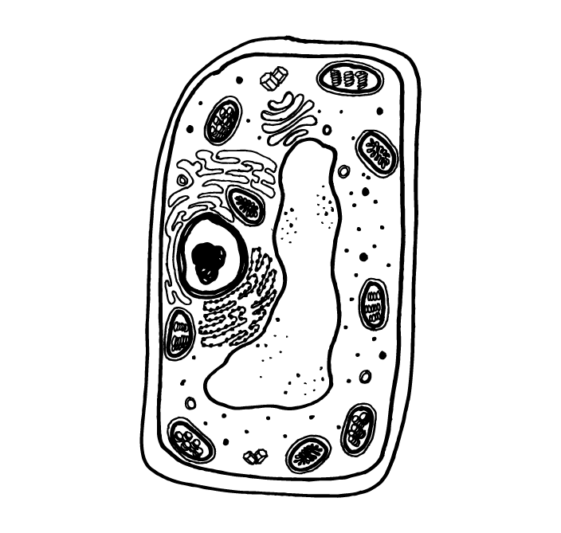




Hour
Day
Temporal scale
Week
Month
Year
Decade
Causes?
Approaches?
Questions?
Implications?
Individual
Ecosystem
Region/Globe
Cell
Tissue
Spatial scale

